Slide 1


ACCESS
Name
Your company logo here
Access your benefits, paycheck, ID cards,
and PlanSource communications in a single location! To install, please scan the
QR code provided.
INSTRUCTIONS TO SCAN THE QR CODE
Open the camera on your phone.
Point the camera at the QR code.
Tap on the link and follow the instructions.
Add your custom QR code here

Slide 2
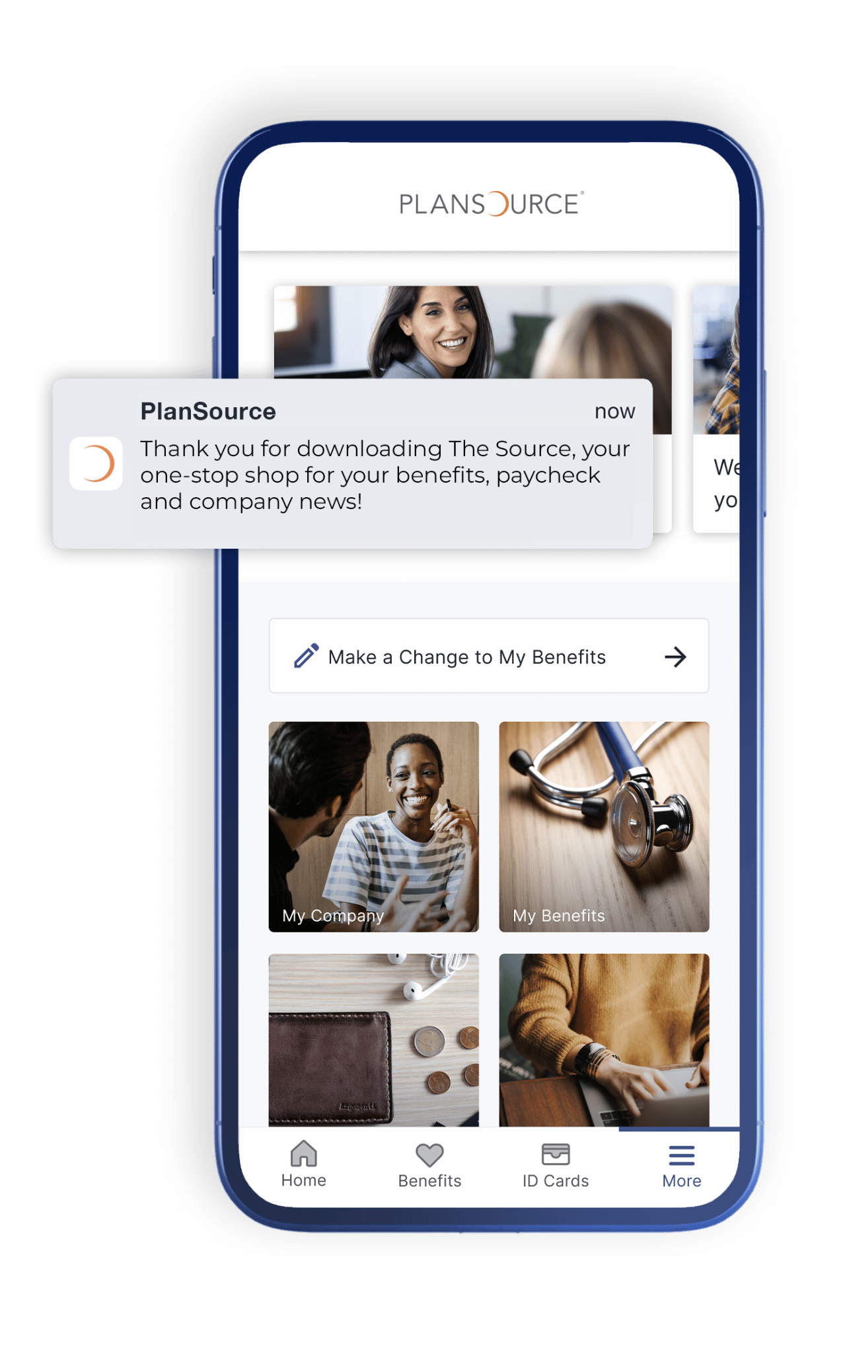

Your company logo here
Flip for instructions

